Slide 1
Investing in the Market
By Andrew Richards
Notes:
Anybody know something about the stock market?
What is a stock?
What is something that always puzzled you? (or something you wish me to explain?)

Slide 2
Intro 1: Scenario

Slide 3
Scenario: your boss gives you a free $1000. What will you do?

Slide 4
Scenario: your boss gives you a free $1000. What will you do?
DO NOW WHILE WAITING FOR CLASS TO BEGIN
a - keep the cash (safe) in wallet
b - save it in bank account
c - invest in a mutual fund/stock
Notes:
by the way. this is what financial advisors do for a living:
straw poll: https://strawpoll.com/38dkrw44v

Slide 5
RESULTS
choice a: nothing
your $1000 will, likely be worth less in two years. (Inflation)
choice b: save
you’ll get an interest of <%1 or so annually

Slide 6
choice c - Invest
best way to grow money (return ranges from 5%-100%);
Can be started with little effort

Slide 7
Outline (on slide 9, click on a topic)

Slide 8
How to get started
Research!!!
Make a (solid) portfolio

Slide 9
Click to go:
What is the Stock Market?
How Companies get Started
How to read a stock chart
How to get started
stocks/etfs
mutual funds
Why Should I Invest?
Myths
Crypto
Notes:
click to go to each topic

Slide 10
What is the Stock Market?

Slide 11
What is a stock?
How to make money?
Vote?

Slide 12
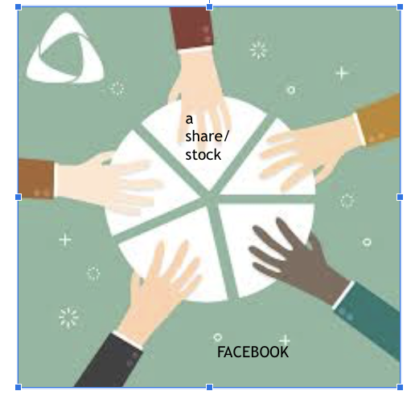
What is a stock?
piece of a pie
become a shareholder
Notes:
Imagine that Facebook is this pie. Then imagine taking a piece of this pie. You can think of this piece as your stock. So there are five shares in total and now you have one. Now, you can Wait until your piece becomes valuable and then sell, or wait for Facebook to pay you a dividend, which is basically a small amount of money , a dollar , as a thank you for simply being an “owner” in the company. The market is just where one buys and sells these “pieces” of the pie.
what is a stock?
an ownership of a company
What is the SM?
A place where people go to buy and trade these stock

Slide 13
The stock market
Sell it for higher!
capital gain
2) Dividend
passive money
Notes:
What are the two ways to make money?
by investing in stock with money you could have invested elsewhere , you are rewarded with some money, other known as dividend (20 cents i.e).
You can sell the stock at a higher price.
*whenever you buy or sell, companies not affected

Slide 14
i.e. Apple
can buy at 100, sell at 125..
OR
earn $0.2/share every 3 months
100 shares? = ?

Slide 15
i.e. Apple
can buy at 100, sell at 125..
OR
earn $0.2/share every 3 months
100 shares? = 0.2* 4 times a year * 100

Slide 16
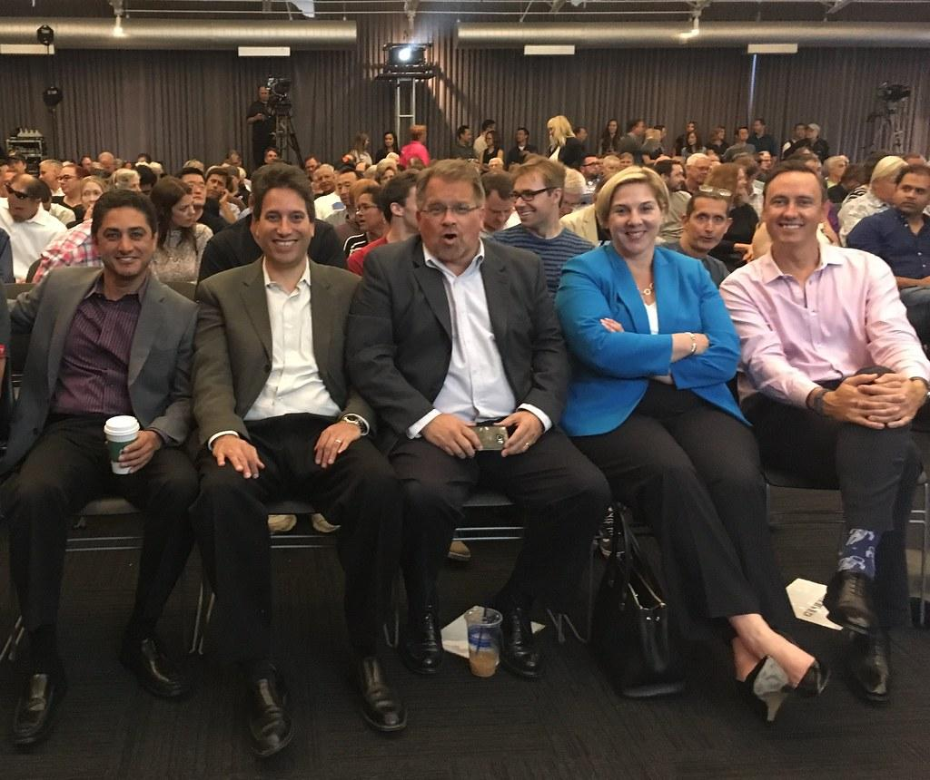
What else can I do?
vote
Notes:
ELABORATE HERE
Companies have “shareholder” meetings -- every month or so.
Opportunities for shareholders to place votes on .. say, who gets to be on leadership or not, or company policies, like Cyber SEcurity
IF CEO has many shares in its company, probably hard to do anything

Slide 17
Concept check: how to earn money passively?
dividend
sell higher
share distribution
capital gain

Slide 18
What is a stock - a piece of a company
To make profit - Sell for higher/Dividend
stock enables you to vote in companies
Takeaways -

Slide 19
How Companies Get on the Stock Market?

Slide 20
How Companies Raise Money via IPO
How stock price is determined

Slide 21
How does it work?
Company start as privately owned
To make more money, It raises an IPO.
investors own your company
company is now public
Notes:
DOES NOT APPLY to NONPROFIT COMPANY - the goal of nonprofit is to boost mission, not make money
-> HSSP: ipo: first time company becomes available on the market; place where money is raised
-> results - company is now ready to be sold on the market

Slide 22
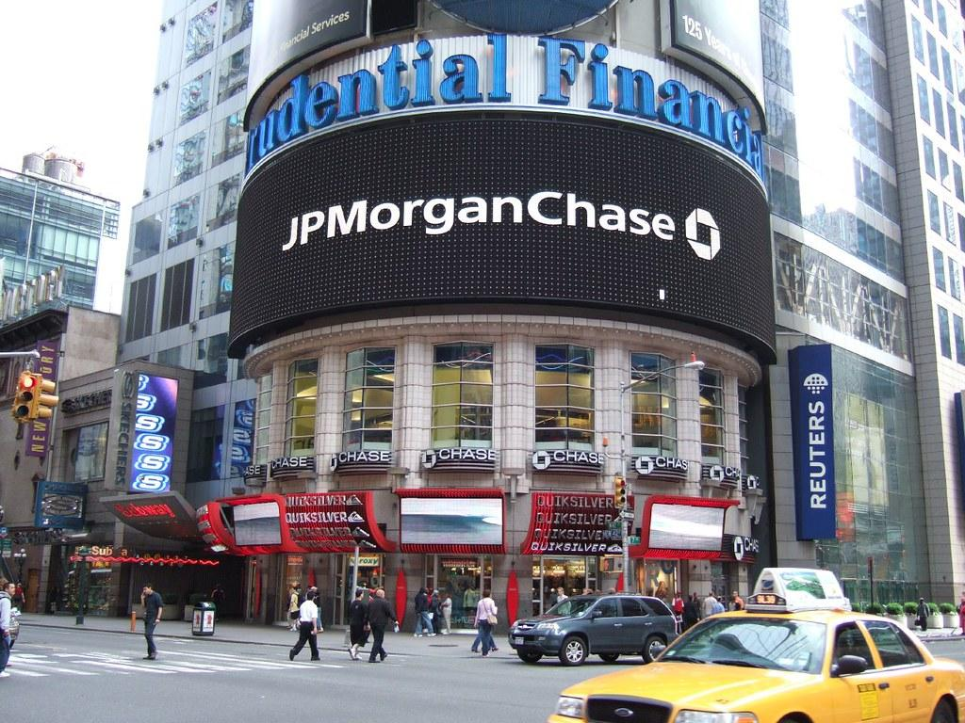
Steps of an IPO
Oatly (vegan milk) needs money
It goes to an investment bank
it looks at company and gives it a price
(see underwriting)
Notes:
underwriter give price and facilitate with the process of selling in general

Slide 23
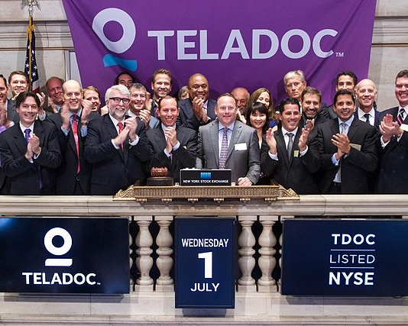
Results of an IPO
Company sells shares at ipo (right)
# of shares determined net income
Can raise 1bn and up

Slide 24
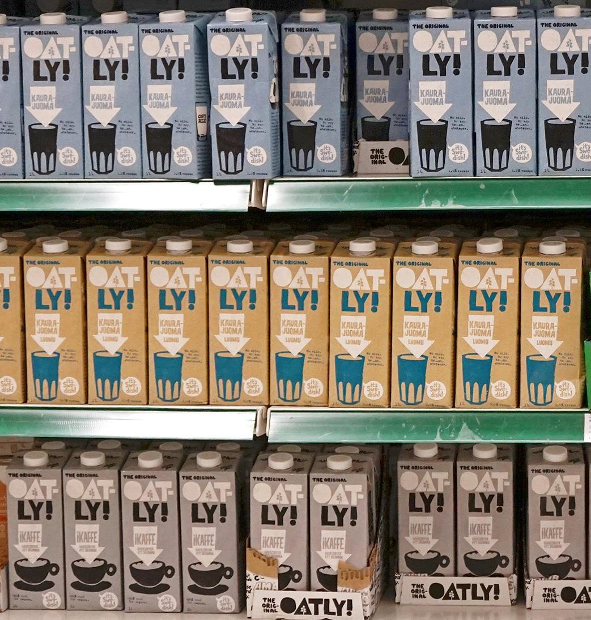
I.e. Oatly, priced at $17
has 84mm shares to give away
If all the shares are sold, what does it get?
Notes:
https://www.wsj.com/articles/oatly-prepares-to-price-ipo-amid-stock-market-declines-11621456361

Slide 25
17 * 84mm shares = 1.4bn
Notes:
https://www.wsj.com/articles/oatly-prepares-to-price-ipo-amid-stock-market-declines-11621456361

Slide 26
Concept check: what do underwriters do ?
b, c, d
sell shares
give price
raise money

Slide 27
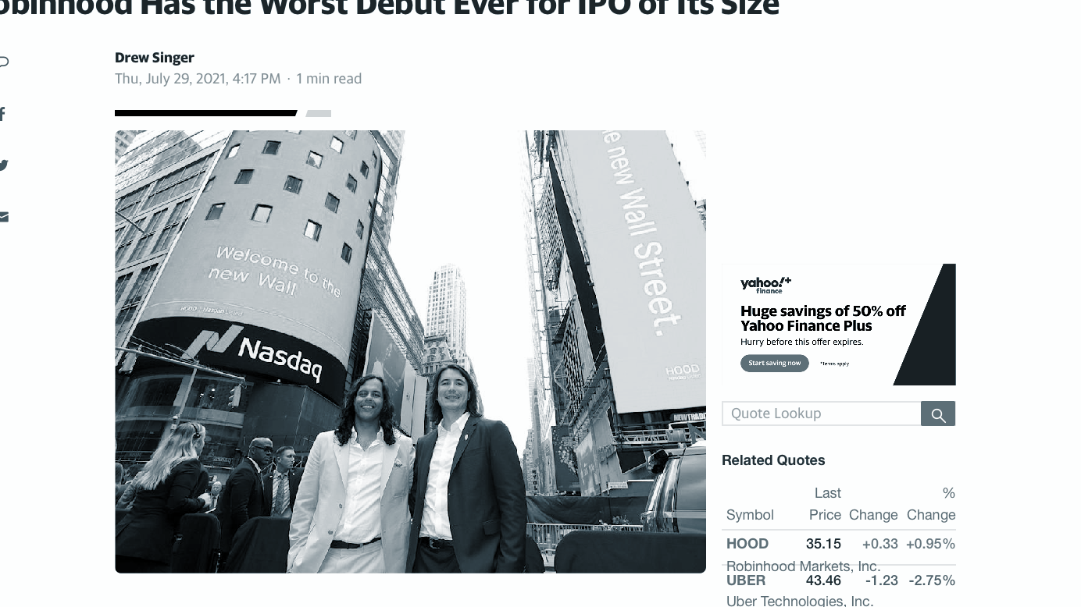
MORE on IPOS: Initial Price Offering
I.e. Robinhood, priced at $38
sold 54mm shares
raised 2bn = 38 * 54mm
Example of not-so-pop IPO
Share price fell below 8.4%
Notes:
https://www.wsj.com/articles/oatly-prepares-to-price-ipo-amid-stock-market-declines-11621456361

Slide 28
The process of raising money is an IPO
Investment Bank -> like bank, but has investing services
they determine company stock price
Takeaways

Slide 29
How to read a stock chart?

Slide 30
Reading stock chart
Buying/Selling stock

Slide 31
How to calculate your Profit
price in nov? in sep? find profit if one share bought and sold in b/t
Notes:
Stock chart - tracks price over time
Find the price of JPG Morgan in Aug:
The price around ~112, did you get that?
What is the price in Sept and in Oct?
~108
~116
did you get these?
If I buy stock in September (~108) and sell around oct (~116), how much profit do I make?
$8
If I buy 3 stocks in September (~108) and sell all 3 around oct (~116), how much profit do I make?
$24
So now you have an idea of how to track profit.

Slide 32
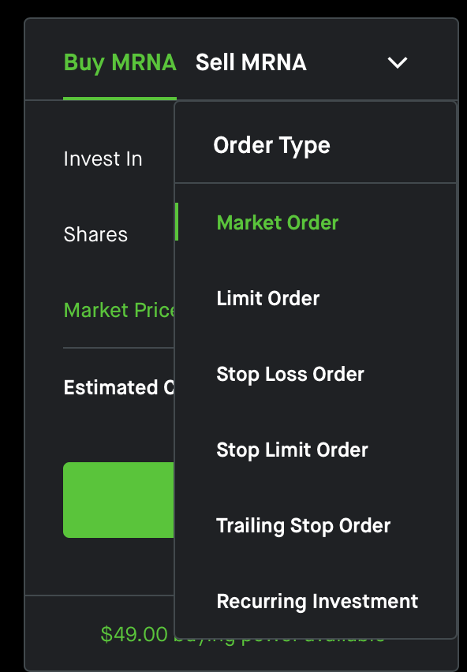
Placing orders...
Notes:
will use robinhood for simplicity sake, but this is a universal concept for others trading platforms

Slide 33
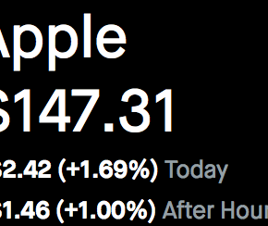
How to Place an Order
Limit Buy - buy shares at the market price OR lower
i.e. order happens IF the price of Apple is 147.31 or lower
Stop Loss Buy - buy shares at the market price OR higher

Slide 34
How to Place an Order
Market Buy - buy shares at the market price ($147.31)

Slide 35
stock charts: gives price over time
Can place market, limit, and stop loss buy/sell
protects you from risky price changes

Slide 36
How to get Started!

Slide 37
invest through apps (i.e. robinhood, etrade)
invest in Mutual Funds (passive)
invest via broker/FA
Trading Simulator

Slide 38
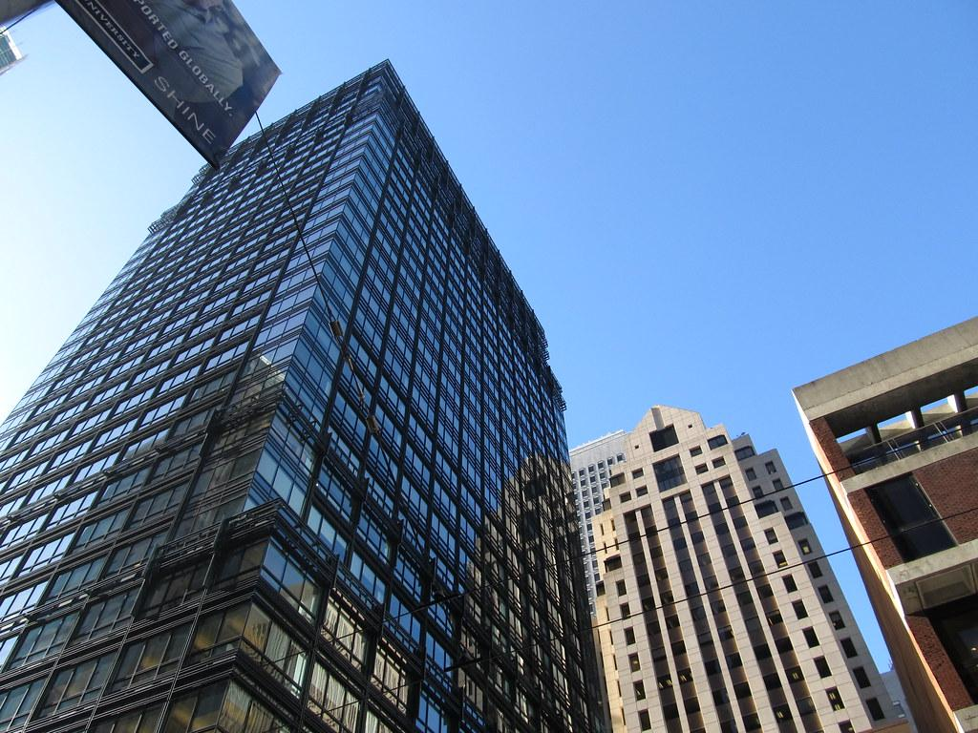
How do you participate in the stock market?
Can do online stock exchange also
e-trade, robinhood, etc.
via a Broker/Financial advisor (jpg)
they buys/sell stocks for you
can help make choices
Notes:
money manager - think hedge fund like berkshire; they make money for you and put it into your acct
*all of this, by the way, is via the secondary market.
online trading more risky - rules put in place to prevent over trading; popular recently (1min)

Slide 39
3) mutual fund
money managers invest your money for you
Will get portion of returns
less work on your end, but more obscure process
require fees
examples: vanguard, s&p, Invesco
Notes:
easier to just dump work on other ppl, but you don’t really know everything their doing!

Slide 40
4) trading simulator
invest in stock market with virtual money!
Enter school competitions
i.e. investopedia

Slide 41
the approaches….

Slide 42
Steps to self-invest online

Slide 43
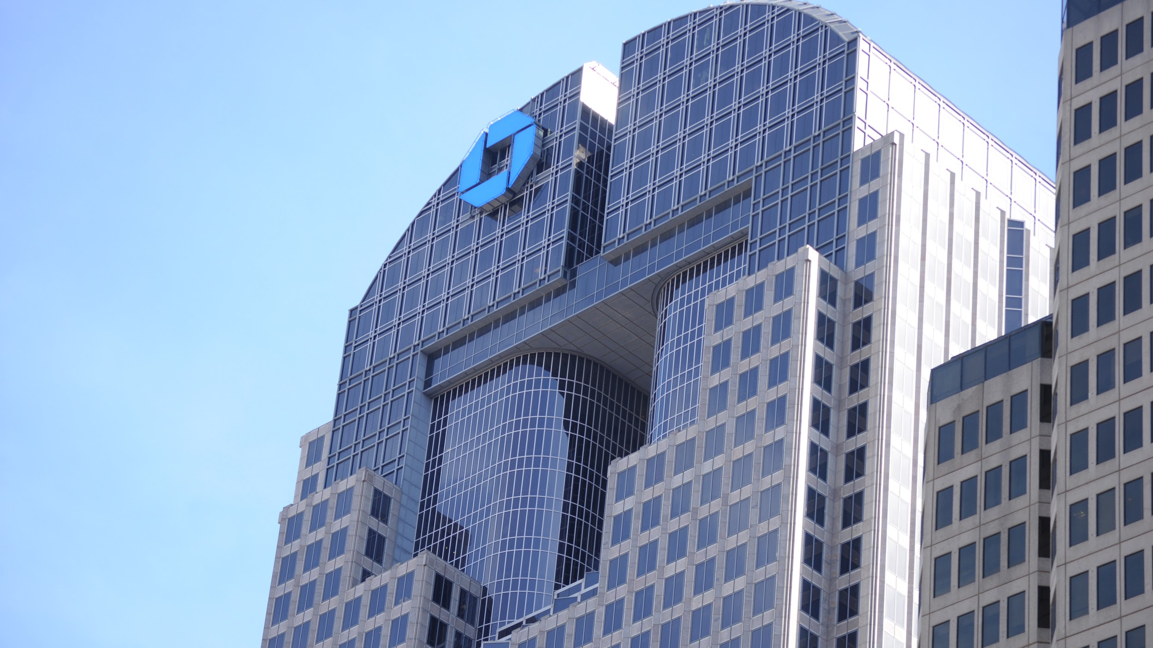
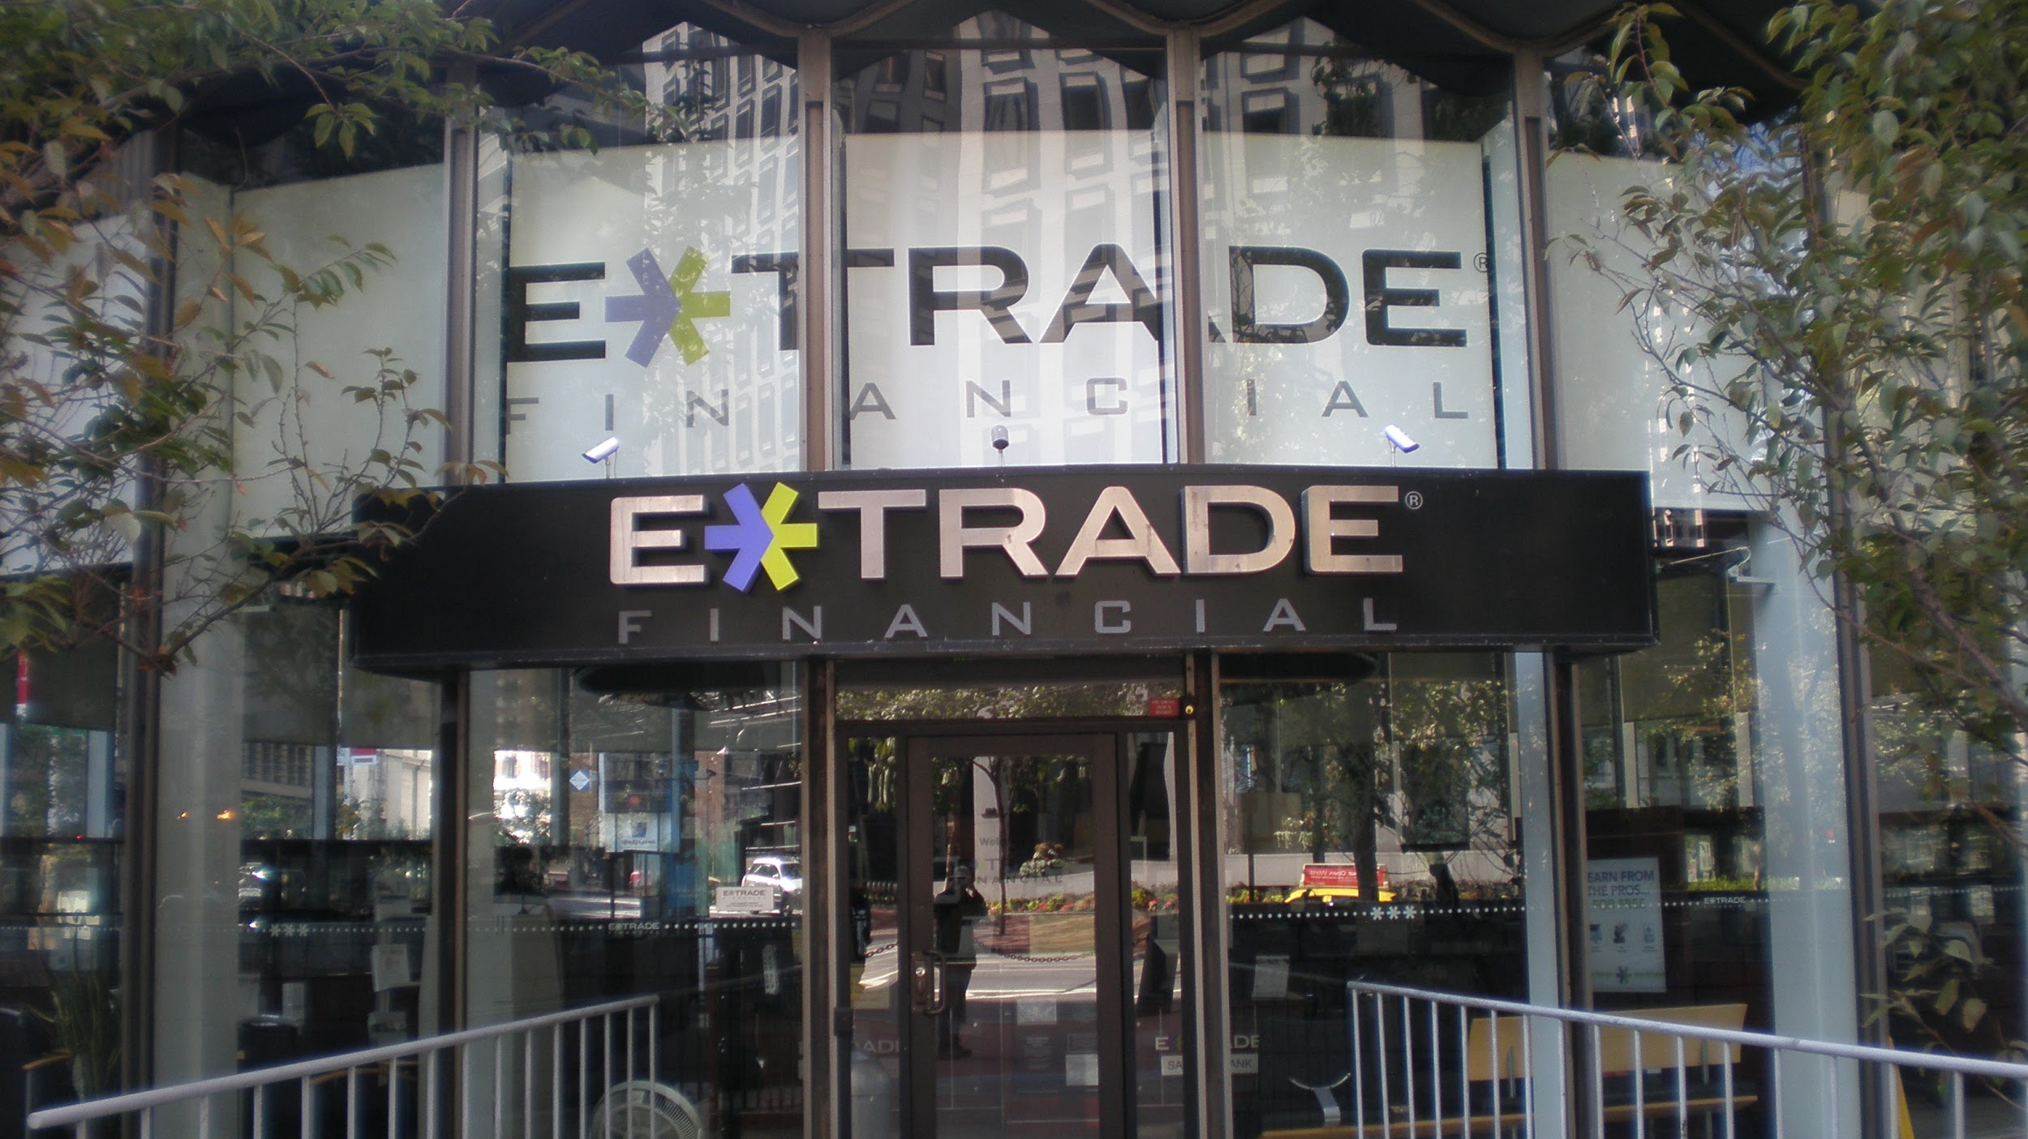
Different ways to invest
Robinhood, e-trade, jpmorgan

Slide 44
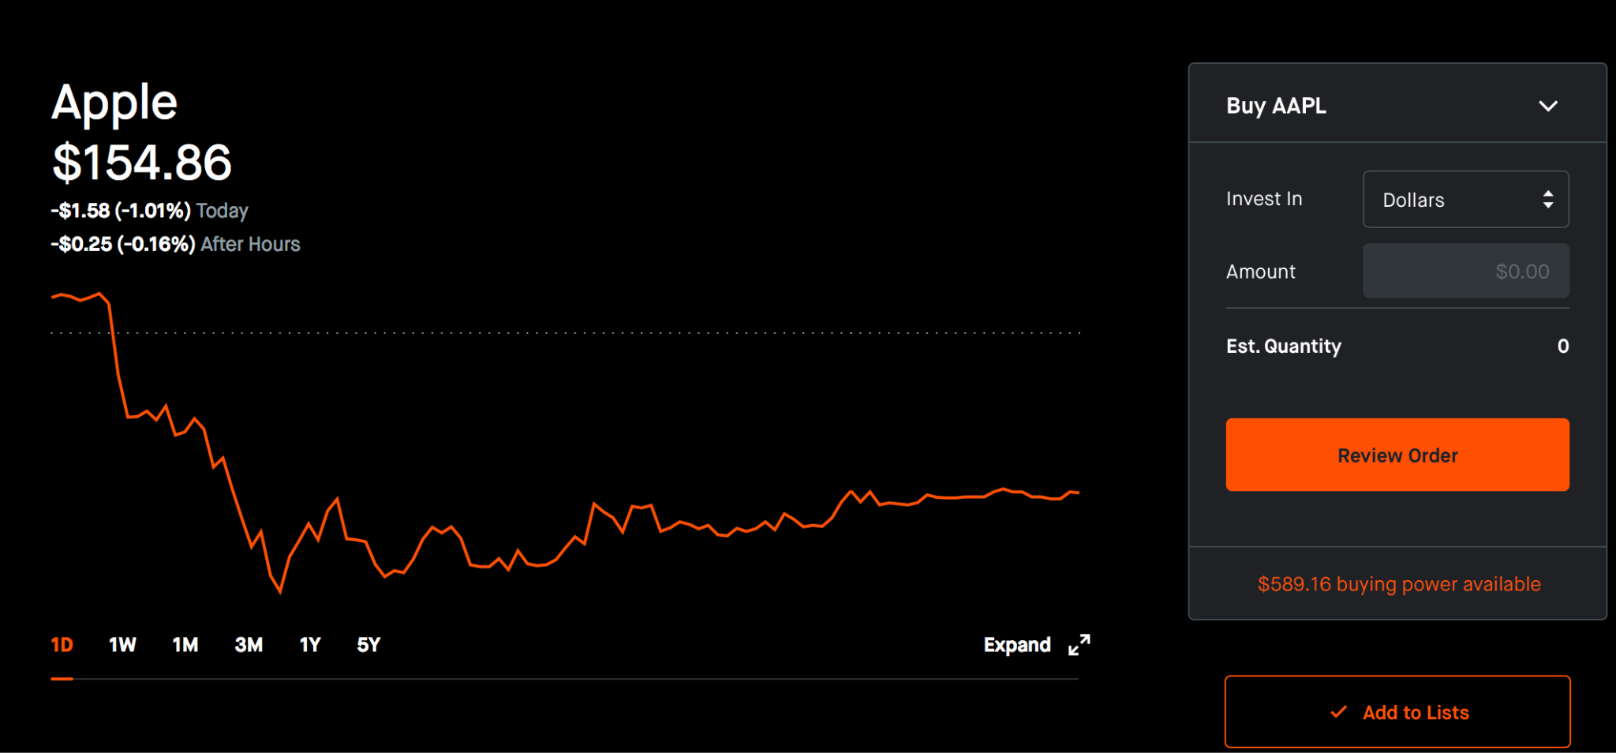
Company name
Price
Price Change
Change of Price over Time
Time ranges

Slide 45
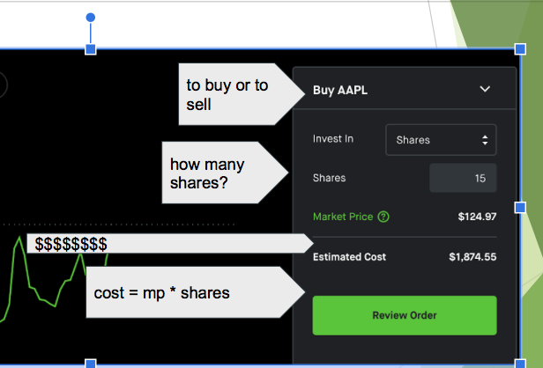
Notes:
depending on what where you go, this is what you might see
how much is 10 shares of apple? 1249.7
process is somewhat similar in person and for mutual funds

Slide 46
Concept check: scavenger hunt
Scavenger Hunt
GO to “ROBINHOOD APPLE”
GO TO THE SITE
Feel free to work in groups or by yourself! But do check your answers with another
Price of apple today?
Did it go up or down, by how much? How about a week ago (give the percent)
Name ONE product it sells
If I invested in AAPL, how much do I get in div a year
Click on the down arrow next to “buy AAPL”
- how many option are listed
> market order - means you buy/sell at a price you see (q1)
PRETEND to buy 7 shares of apple, what is the
“Estimated cost” on the website?
Notes:
Scavenger Hunt
Complete all questions - in groups or if necessary alone. Feel free to use Google as a resource
Google “Robinhood apple” -> try the first result
Price of apple today?
Did it go up or down, by how much? a week ago (give the percent)
Name ONE product it sells
Also What geographic areas does it operate? XXXX
If I invested in AAPL, how much do I get in dividend per share (0.59)
Click on the down arrow next to “buy AAPL”
- how many option are listed
> market order - means you buy/sell at a price you see (q1)
PRETEND to buy 7 shares of apple, what is the
“Estimated cost” on the website - $1,021.16

Slide 47
With online apps you can
locate stocks
buy/sell
see price

Slide 48
ETFs - alt to stocks

Slide 49
ETFs - less financial risk than stocks

Slide 50
Exchange Traded Fund
an ETF (exchange traded fund)
a fund that allows you to invest in one’s portfolio
traded like a stock
low risk, lower return annual
easy way to invest in apple, other companies at the time;
Notes:
regular stocks riskier but better payoff

Slide 51
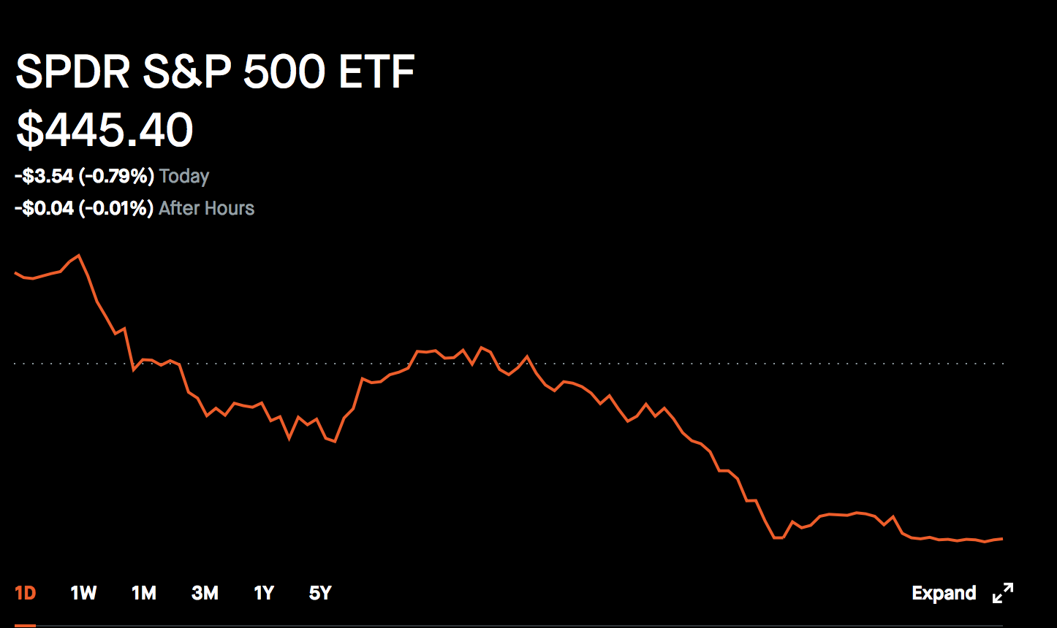
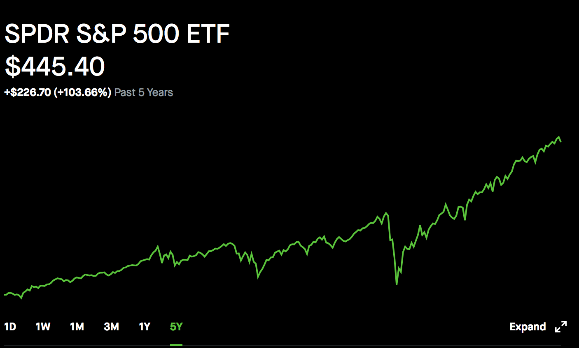
Exchange Traded Fund
ETF (exchange traded fund)
can find by simply inputting it
i.e. S&P 500 (Standard & Poor) (left)
- steady
tracks 500 “financially sound” companies (i.e. fb, apple, etc.)
Notes:
regular stocks riskier but better payoff

Slide 52
Benefit of ETFs?
choose one (many apply)
low-risk
very high returns
accessible to invest in
can only invest in one company

Slide 53
ETFs allows you to invest in groups of companies
less riskier than a stock
Stable returns

Slide 54
Steps to invest with mutual fund

Slide 55
Outline
Mutual funds - a method that is less research/effort
Getting Involved online

Slide 57
Steps
Look up “Mutual Funds”
Choose a type of fund
Find the Prospectus
info on fund

Slide 58
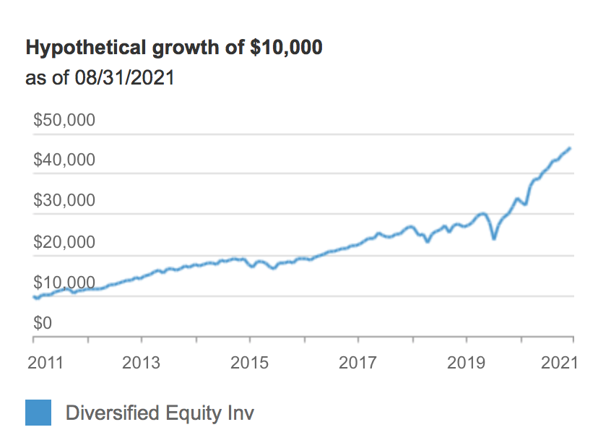
Prospectus info
Notes:
AN EXAMPLE ONLY!

Slide 59
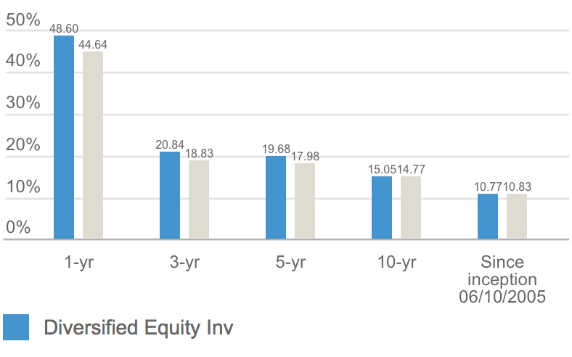

Slide 60
3) After you chosen a specific fund; open an acct (via a form online)
IRA, for child, etc.
4) invest in shares as you would with stocks

Slide 61
5) wait a year or so for mutual fund returns
(you can withdraw, but may be discouraged)
6) OR repeat 1-2 as necessary until content

Slide 62
practice researching!
SECTION 2: MUTUAL FUNDS
GO TO:
https://investor.vanguard.com/mutual-funds/profile/performance/vfiax
REPEAT THE ABOVE
Find Price
What is the funds return since inception (11/13/2000)?
Go to the portfolio tab - what companies are in this stock portfolio?
Go to Fees and Minimum; IF I invest, what is the minimum FEE?
Dividend yield in 2020 (sum it up) that’s what you’d have in a year for one sh
Notes:
SECTION 2: MUTUAL FUNDS
GO TO:
https://investor.vanguard.com/mutual-funds/profile/performance/vfiax
REPEAT THE ABOVE
Find Price
What is the funds return since inception (11/13/2000)?
Go to the portfolio tab - what companies are in this stock portfolio?
Go to Fees and Minimum; IF I invest, what is the minimum FEE?
Dividend yield in 2020 (sum it up) that’s what you’d have in a year for one sh

Slide 63
MFs allows others to invest for you
Minimum fees requires BUT
less personal effort

Slide 64
why I should invest?

Slide 65
why I should invest?
Reasons to invest isn’t just profit
Philanthropy (helping others)
Save money for long-term
and more…..(i.e. social impact)

Slide 66
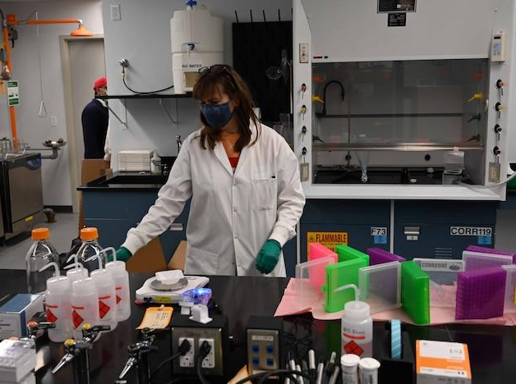
Why do people invest in the stock market?
social impact;
fund companies with high value
influence key company decisions
Notes:
To support companies, who use investors’ (your) money to fund their operations (paying workers, redeveloping drugs, RD etc.)
i.e
1)clean energy stocks! - there’s increasing awareness of climate change impact; biden election is focusing partly on reversing that impact.
(Enphase Energy - Solar stock)
*AI companies!
2)Health care - prosthetic tools/drugs - vaccine!
*Beyond Meat - sells vegan meat; for those who want better climate and healthier lifestyle;
Impact company decisions -
you are allowed to board of directors
maybe one has an ethical stance, you might want to vote to keep in pwr
like BK and environment
Common vs preferred equity

Slide 67
Cont.
Money from ipo funds various operations of including:
goods production
renting offices
hiring employees
Notes:
What happens to your money after you invest?
shares are then traded among investors (doesn’t affect company)
Why do ppl invest in the stock market?

Slide 68
Why do people invest in the stock market?
Personal reasons
save extra money
a way to make profit
philanthropy/personal
Notes:
A place to spend extra money;
like a bank acct; but maybe more productive? (earn passive income)
is it better or worse?
To make a significant amount profit.
which can be used to raise money.
which can be used for self or others
Common vs preferred equity
what’s one platform for trading (Either online or in real life)

Slide 69
WHAT’S A REASON TO INVEST?
IN ONE WORD!

Slide 70
How to Choose???

Slide 71
Start slow
research a famous company
research ETFs (Exchange Traded Fund)
research mutual fund
can requires INTENSE research
i.e. Technical Analysis

Slide 72
DISCLAIMER: Not an advocate of any method; must research first!!

Slide 73
Myths
& clarifications
about investing!!!!

Slide 74
investing is gambling
you can invest in ideas/products
the price trend is reliable
4) Investing is for the rich
investing is time-consuming

Slide 75
Investing is like gambling, right?
Notes:
Gambling - making a guess that is unfounded (based on your *feelings*)
i.e. I bet the ball is in your right hand
Not gambling
i.e. I bet the ball is in the right hand BECAUSE your right hand looks less relaxed than your left

Slide 76
Notes:
Gambling - making a guess that is unfounded (based on your *feelings*)
i.e. I bet the ball is in your right hand
Not gambling
i.e. I bet the ball is in the right hand BECAUSE your right hand looks less relaxed than your left
The more research, the better

Slide 77
]

Slide 78
2) You can invest in ideas or products?
Notes:
Not directly, but by funding businesses via the market you do this!

Slide 79
Notes:
Not directly, but by funding businesses via the market you do this!

Slide 80
3) always follow the trend!!

Slide 81
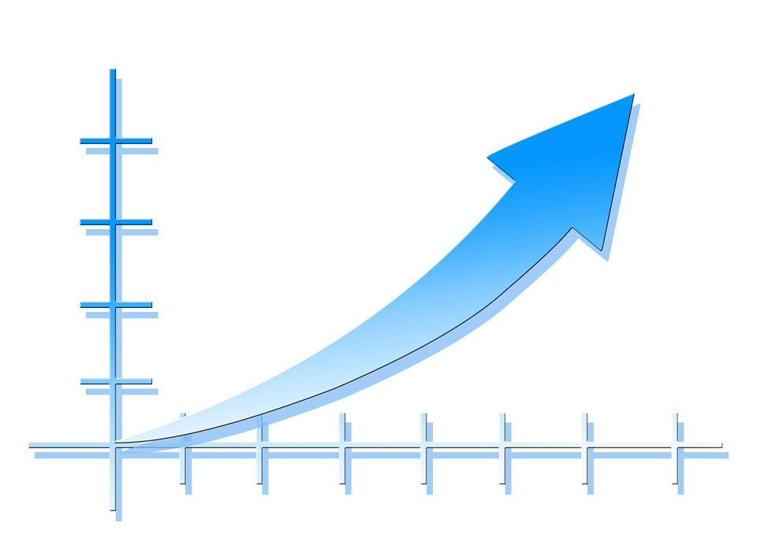
Notes:
if apple is rising
it doesn’t mean it will FOREVER
an example of when stocks fall……….
it’s like when the pandemic happened

Slide 82
4) investing is for the rich!

Slide 83
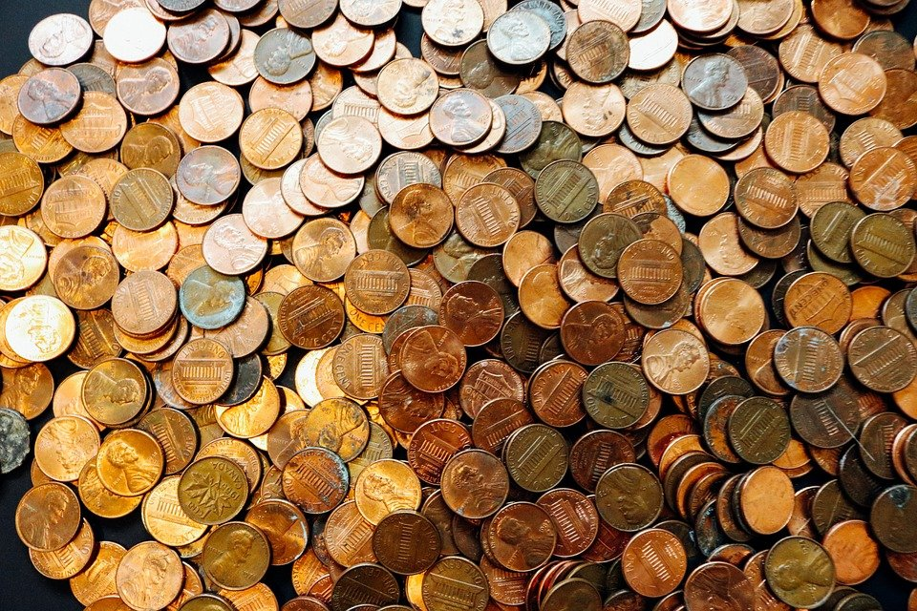
Penny Stocks! < $5
Notes:
*can be volatile

Slide 84
5) investing is time-consuming

Slide 85
Mutual Funds - ppl invest for your
yahoo finance, market watch, robinhood

Slide 86
investing is manageable!

Slide 87
A look at cryptocurrency

Slide 88
What Cryptocurrency?
Is it useful?
Is it an investment to make

Slide 89
What is Cryptocurrency?

Slide 90
Cryptocurrency
Digital Currency (bitcoin, ethereum, etc.)
decentralized
non-regulated by govt
anonymous
Notes:
What is it? - digital money unregulated by gov
What is it used for?

Slide 91
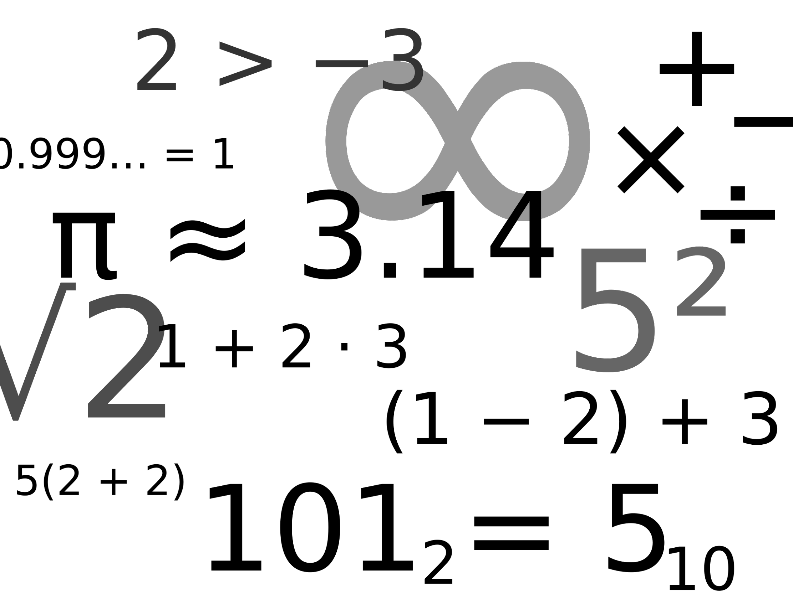
Cryptocurrency
2) Created through mining
solving math problems
3) transaction happens via Blockchain
Notes:
What is it? - digital money unregulated by gov
What is it used for?

Slide 92
Is it useful? - Cons
> Seen as a tool for gambling;
> No use in most online retailer;

Slide 93
Is it useful? - Pros
anonymous transactions
protection from bank failures

Slide 94
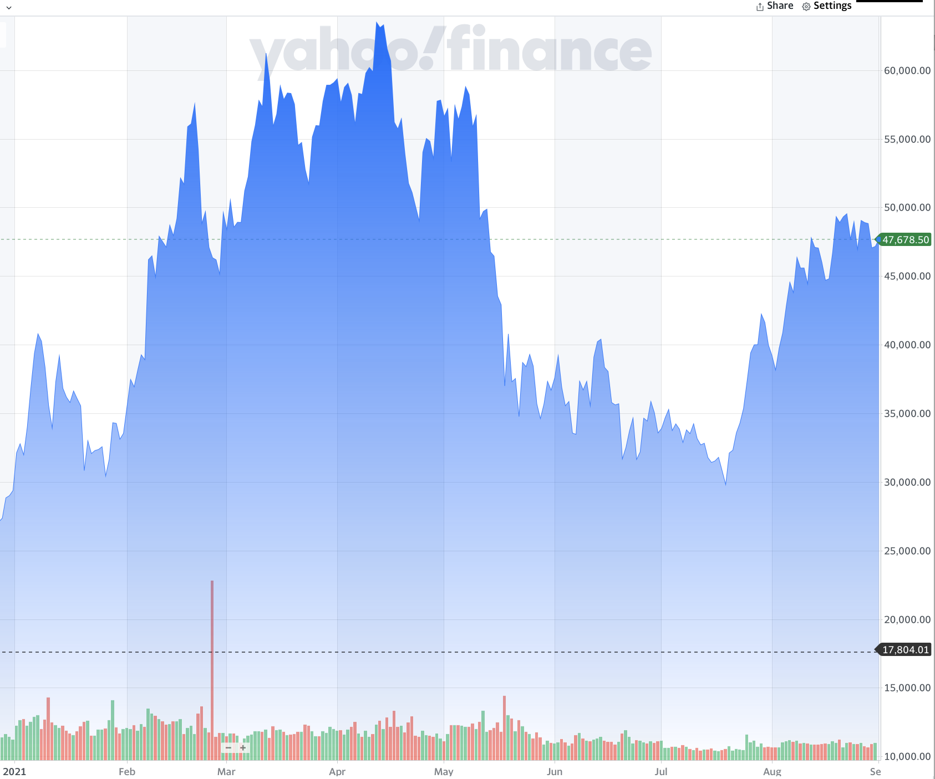
Should I invest?
~ Bitcoin shows volatility
~ large price range (17k-47k)
BE CAREFUL!!!!
Notes:
what was the price in 2021? in Sept?

Slide 95
On the other hand to consider
-> greater use of digital currency possibly
-> security issues?
-> not well appreciated by all

Slide 96
WHAT’S A REASON TO INVEST?
What is NOT a feature of cryptocurrency transactions
it’s decentralized
It’s regulated
It’s transparent
It’s volatile (rapid price swings)

Slide 97
Cryptocurrency - digital
used for online, anon transactions
not well liked (but has potential)

Slide 98
stocks are a piece of the pie
companies get on Stock Market via IPO
stock charts give price of stock over time
Three ways to get started: stocks, mutual funds, etfs
E-trade / Robinhood
Investing is not just profit - can influence company position
Investing is manageable!

Slide 99
Next Steps..

Slide 100
Peruse/Download a trading app/site (e-trade/robinhood) OR
make an account on investopedia
Begin researching!
Start with FAMILIAR companies (apple, tesla…)
when ready, make an account on a trading platform
after a while, look at other ways to invest (mutual fund/ETFS)

